Slide 1
Maintenance Management System
Agri-Tech Hackathon 2023
Bahir Dar Institute of Technology
January 2023

Slide 2
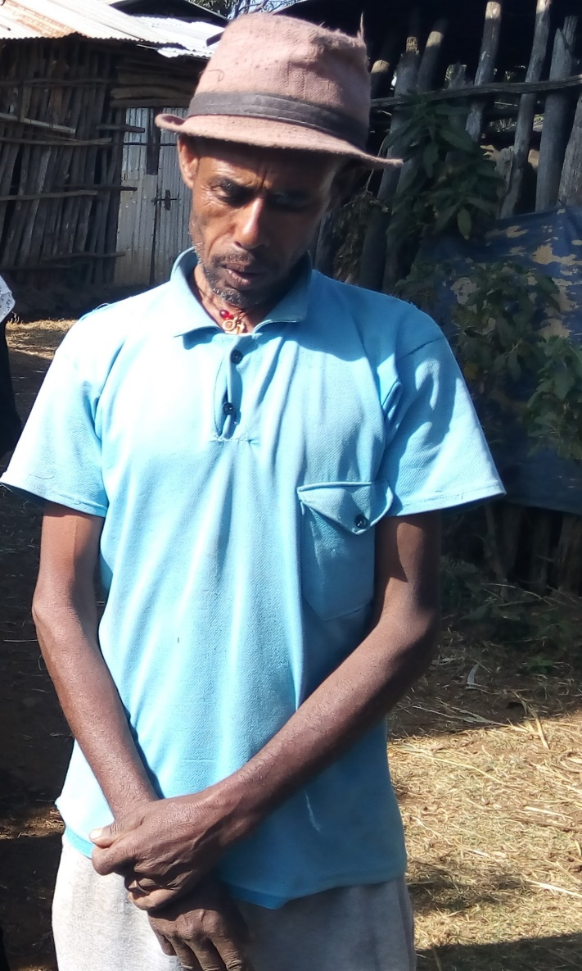
The industrious Farmer
ጥሩ ስራ ሰርታችሁ ኑ እሸ!
Some history about mr abate

Slide 3
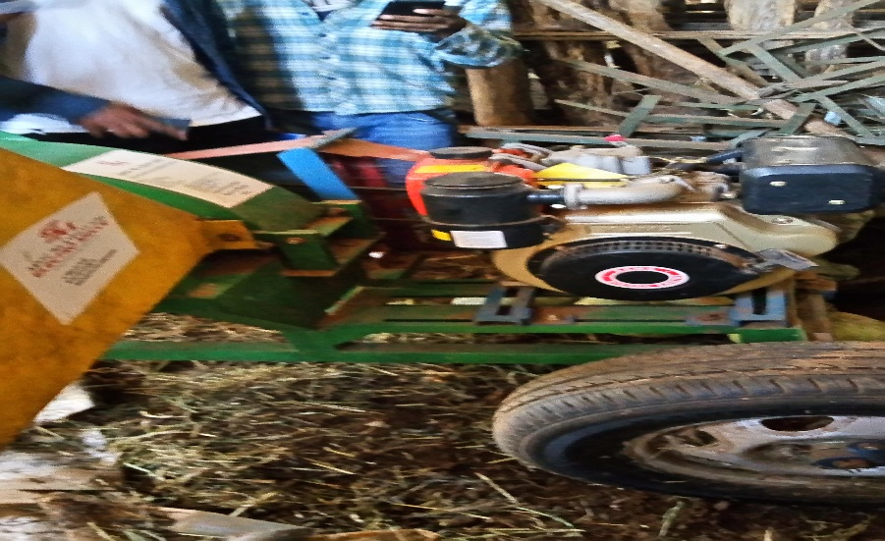
Motivation
Machine failures
Customers have no connection
to the maintainer

Slide 4
Objectives
Develop effective system to Simplifiy Mantainance problem

Slide 5
System diagram
Call center
Mainteners
Customers

Slide 6
Required materials for the project
Computer
Internet Connection

Slide 7
Challenges
Lack of Internet access
Lack of technology experiance
understanding customer’s needs

Slide 8
Group Members
Name
Composition
1.Mahlet Adugna Computer Enginnering
2.Wedaje Yirdaw Mechanical Enginnering
3.Birhanu Atilaw Computer Enginnering
4.Nuru Ahmed Computer Enginnering
5.Eyob Software Enginnerin
6.Yeabtsega Gashaw Cmputer Enginnering

Slide 9
Thank you

